Slide 1
Employee Data Analysis using Excel
STUDENT NAME :SHYAM C.G
REGISTER NO : 312205364/asunm285a22321
DEPARTMENT : B.COM(GENERAL)
COLLEGE : SRIDEVI ART& SCIENCE COLLEGE

Slide 2
PROJECT TITLE
Employee Performance Analysis using Excel

Slide 3


AGENDA
Problem Statement
Project Overview
End Users
Our Solution and Proposition
Dataset Description
Modelling Approach
Results and Discussion
Conclusion
3/21/2024 Annual Review

Slide 4

PROBLEM STATEMENT
Employee Performance analysis using Excel involves evaluating and measuring an employee’s work effectiveness and efficiency based on key performance indicators (KPIS). This data is than analyzed using Excel’s function and tools, such as pivot tables, charts, and conditional formatting, to identify patterns, strengths, and areas for improvement. The analysis helps in making informed decisions regarding training needs, promotions, and overall workforce optimization.

Slide 5

PROJECT OVERVIEW
.
Employee performance analysis using Excel involves evaluating and measuring an employee's work effectiveness and efficiency based on key performance indicators (KPIs). This data is then analyzed using Excel's functions and tools, such as pivot tables, charts, and conditional formatting, to identify patterns, strengths, and areas for improvement. The analysis helps in making informed decisions regarding training needs, promotions, and overall workforce optimization.

Slide 6

WHO ARE THE END USERS?
Human Resources (HR) Managers
Department Managers/Supervisors
Senior Management/Executives
Employees

Slide 7

OUR SOLUTION AND ITS VALUE PROPOSITION
Conditional formatting-Missing
Filter- Remove
Formula-Performance
Piot-Summery
Graph-Data visuvalaiztion

Slide 8
Dataset Description
Employee = Kaggle
26 – Features
9 – Features
Emp ID –Number
Name –Text
Employee Type
Performance level
Gender- Male & Female
Employee Rating- Number

Slide 9

THE "WOW" IN OUR SOLUTION
Predictive Analytics: Integrating predictive models to forecast future performance trends based on historical data, giving managers a proactive approach to workforce planning.
Automated Alerts: The tool can be set up to send automated alerts for critical performance issues ensuring that managers are immediately notified when attention needed
3/21/2024 Annual Review
9

Slide 10
MODELLING
In the "Employee Performance Analysis Using Excel" project, the modeling phase involves setting up the Excel workbook with various tools and techniques to analyze and visualize the data effectively. Here's how each component will be used:
Data Filtering
Purpose: To sort and refine the data to focus on specific criteria, such as department, date range, or individual employee performance.
Implementation: Excel's filtering feature will be applied to datasets, allowing users to easily narrow down the data to view only the relevant information. For example, filtering by department or by performance rating.
2. Pivot Tables
Purpose: To summarize and analyze large datasets by grouping and aggregating data based on different performance metrics.•
Implementation: Pivot tables will be used to dynamically calculate and display key performance indicators (KPIs) such as average task completion time, total hours worked, or percentage of targets met. This will allow users to view performance metrics by different categories, like employee, team, or month
10

Slide 11
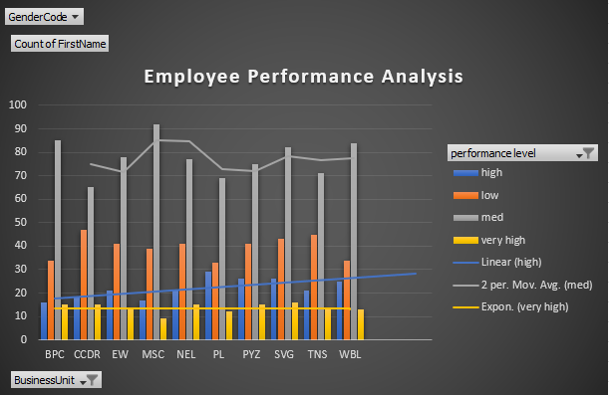
RESULTS
11

Slide 12
conclusion
The “Employee Performance Analysis Using Excel” project provides a robust and user-friendly solution for evaluating and managing employee performance. By leveraging Excel’s powerful tools-such as filtering, pivot tables, charts, and conditional formatting-the project transforms raw performance data into actionable insights. The resulting interactive dashboards and customizable reports empower managers to make data-driven decisions, optimize workforce productivity, and foster continuous improvement across the organization. This solution not only streamlines performance management but also offers a cost-effective, scalable approach to enhancing overall organizational efficiency.

